Slide 1
Homelessness in Marin

Slide 2
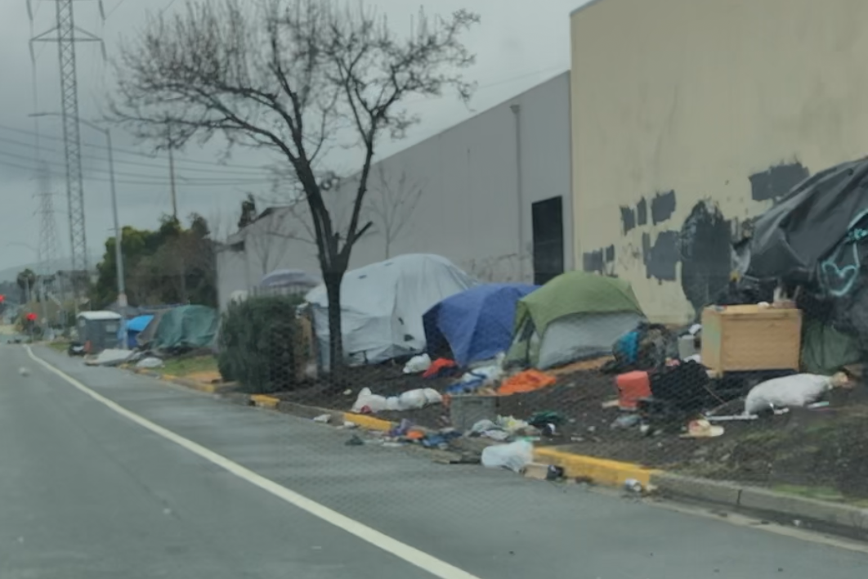
San Rafael
March 14th, 2025
7:19 PM

Slide 3

Homelessness has been and continues to be problematic in the United States but most especially in California
30% of the homeless in America live in California

Slide 4

Los Angeles - Skid Row – highest number of homeless in US living in makeshift encampments, overcrowded shelters which signals urban destitution
Oakland
San Francisco – the Tenderloin - signals the juxtaposition of economic prosperity and social inequality despite the creation of navigation centers, source is chronic substance abuse and mental health issues
Despite $24 billion across numerous state agencies which includes $4.85 billion in flexible funding to local jurisdictions and $1 billion in Encampment resolution Funding and $3.3 billion for Project Home Key there are currently an estimated 1,800 homeless people in the SF Bay Area

Slide 5
The Language of Homelessness
Home / less /ness
Home as noun - A place where one lives , an abode, where one lives with family, native land or place, habitat, social unit of a family living together, in games – a goal “Home is where your heart is”
adj – domestic – of or pertaining to home “that strikes home” loci of emotion
adverb – one’s country, a vital center or core, a place where “it” belongs “to drive a nail
home”
emotional, physical, social and political meanings
- Less - a privative adjective suffix which means lacking or less
-ness also a suffix used primarily to form nouns denoting a state, condition, quality or degree expressing degrees of separation
“experiencing” homelessness – living through an event or having the experience of or undergoing this event
Why use this language?

Slide 6
Who are the Homeless?

Slide 7
They are people who:
4 types Chronic – long term disabilities Episodic – multiple instances Transitional – life event that precipitates Hidden – couch surfers
1. health issues or mounting medical bills
2. job loss
3. renters who face rent increases
4. youth who time out of foster care
5. Substance abusers
6. mental health issues
7. divorce
8. domestic violence
9. legal problems with partner
10. lost home due to natural disaster

Slide 8
Is Homelessness New?
Homelessness is not new; it’s tied to immigration and migratory patterns, natural disaster, social and cultural change
In the early days of American culture, called the wandering poor – vagrants, tramps, hobos
Following the Indian Removal Act of 1830, mass migration and displacement of native Americans
Civil War – contraband
Post-Civil War – Black Codes restricted the movements of blacks, Gold Rush
Late 19th century, railroad construction esp. the West and California
Depression (1930’s) migration of laborers brought in by the government to solve labor problems Emergency Relief and Construction Act of 1932 and the National Industrial Recovery Act of 1933
Steinbeck – The Job Family The Grapes of Wrath Of Mice and Men
Post WW II number of homeless men increased

Slide 9
Government Involvement
Dept. of Agriculture, Commerce, Defense, Education, Energy, Health and Human Services, Housing and Urban Development, Labor, Transportation, Vetern’s Affairs, Office of the Budget, SSA, USPS, White House, Faith Office
Public Law 111-22, the Stewart B. McKinney’s Homeless Assistance Act, as amended by The Homeless Emergency Assistance and Rapid Transition to Housing (HEARTH) Act of 2009
Individuals and families who lack a fixed, regular, and adequate nighttime residence
Individuals and families who will imminently lose their primary nighttime residence
Unaccompanied youth
Individuals who are fleeing domestic violence, dating violence, sexual assault, stalking or other life-threatening conditions that relate to violence

Slide 10

Housing is a Hunan Right (?)
1944 – F. D. R. in his State of the Union address argues that the government must Respect, Protect and Fulfill
The government must avoid actions that prevent people from accessing adequate housing
The government must ensure that third parties such as private entities or individuals does not violate the right to housing
The government must take positive steps, like allocating resources and implementing policies, to make housing available to those who cannot achieve it for themselves
“While not requiring the government to provide free housing for everyone, the right to housing implies a responsibility for government to ensure access to adequate housing potentially through various means like public housing, housing subsidies, or regulations to make housing more affordable and accessible”
But Housing is a Human Right is pervasive in the literature on California homelessness

Slide 11
Homelessness in San Rafael and Novato
San Rafael City Council “layered approach” Colin “compassionate, restores order and is effective”
1. Emergency shelters: Mill Street, Family Center at 430 Mission Avenue, Center for Domestic Peace
2. Sanctioned “camping” : Mahon Creek 2.2 from a 6 Million dollar grant from the California Interagency Council on Homelessness for 49 tents along Mahon Creek closed down the unsanctioned camp on Anderson spent 80,000 to remove trash and debris in October 2024, 657,000 annually to FS Global, an NGO based in Sebastopol run by Kaydn Schumann who “borrowed the name of well-known Harvard epidemiologist William Foege and uses a postal box at the Postal Annex in Sebastopol
3. Transitional housing: Project Home Key – started due to Covid, using hotel rooms for homeless 260 million from the state, CARES Act American Rescue Plan funding (FEMA left CA with a balance of $300 million) conversion of units from nonresidential to residential – apartments, adult residential facilities, motels, hotels (Casa Canal) 34.5 million of supportive housing for 32 apartments (city paid 7.2 million so who took the rest – Eden housing?

Slide 12
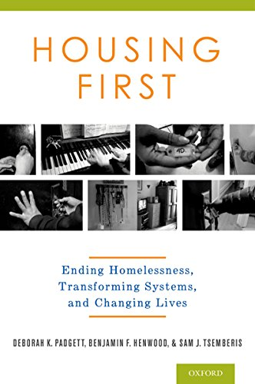
Housing First
On January 1, 2026, Housing First will be the legal approach to housing the homelessness in California
1. Does not mandate any person to seek help with addition
2. Ignores mental health status
3. Ignores previous criminal activity
4. ignores economic history
5. Goal is to create housing stability before requiring anything of the person

Slide 13
Ending Homelessness
Question: how can you eradicate homelessness with what is available
Funds
Social outreach
Government programs
Community response
What common sense approach might be offered to combat the outrageous expenditures to offset the “homeless industrial complex”

Slide 14
Thank you

